Slide 1

CSR research for Facebook
Presented by Stephanie

Slide 2
Privacy- Facebook’s failure in CSR
Tracking of non-members of Facebook in
(reported by American Today in November, 2011)
Sharing private messages and contacts' details without consent
(reported in December, 2018)
Denial of location privacy, regardless of user settings
(reported in December, 2018)
Notes:
An article published by USA Today in November 2011 claimed that Facebook creates logs of pages visited both by its members and by non-members, relying on tracking cookies to keep track of pages visited.
In early November 2015, Facebook was ordered by the Belgian Privacy Commissioner to cease tracking non-users, citing European laws, or risk fines of up to £250,000 per day.^{[44]} As a result, instead of removing tracking cookies, Facebook banned non-users in Belgium from seeing any material on Facebook, including publicly posted content, unless they sign in. Facebook criticized the ruling, saying that the cookies provided better security.
In December 2018, it emerged that Facebook had, during the period 2010–2018, granted access to users' private messages, address book contents, and private posts, without the users' consent, to more than 150 third parties including Microsoft, Amazon, Yahoo, Netflix, and Spotify. This had been occurring despite public statements from Facebook that it had stopped such sharing years earlier.
In December 2018, it emerged that Facebook's mobile app reveals the user's location to Facebook, even if the user does not use the "check in" feature and has configured all relevant settings within the app so as to maximize location privacy.

Slide 3
Type of CSR
The ISO quality standard ISO2600-2010: Guidance on Social Responsibility includes 'ethical behavior' among its seven key principles of socially responsible behavior:
Accountability
Transparency
Ethical behavior
Respect for stakeholder interests
Respect for the rule of law
Respect for international norms of behavior
Respect for human rights

Slide 4
Type of CSR
It is unethical for companies to disclose the privacy of users without their permission. Facebook has unethical business practices for multiple times. This represents they has:
No respect for stakeholders interests
No respect for law
Notes:
. (In early November 2015, Facebook was ordered by the Belgian Privacy Commissioner to cease tracking non-users, citing European laws, or risk fines of up to £250,000 per day.)
As a result, instead of removing tracking cookies, Facebook banned non-users in Belgium from seeing any material on Facebook, including publicly posted content, unless they sign in. Facebook criticized the ruling, saying that the cookies provided better security.

Slide 5
Research sources
“Business Ethics and Corporate Social Responsibility Debunked.” Diligent Corporation, https://www.diligent.com/insights/esg/business-ethics-and-corporate-social-responsibility/.
“10 Corporate Social Responsibility Examples You Should Know.” Prowly Magazine, 28 Sept. 2021, https://prowly.com/magazine/corporate-social-responsibility-examples/.
“Privacy Concerns with Facebook.” Wikipedia, Wikimedia Foundation, 31 Dec. 2022, https://en.wikipedia.org/wiki/Privacy_concerns_with_Facebook.

Slide 6
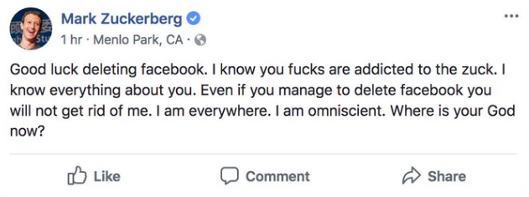
Revolution
Agrees to undergo an independent privacy evaluation every other year for the next 20 years.
A $16,000-per-day penalty for violating each count of the settlement. (November, 2011)
Complies Europe’s data protection law
Appeals the court’s ruling.
Apology tour
Changed the policy
Notes:
Facebook agrees to undergo an independent privacy evaluation every other year for the next 20 years.
Facebook remains liable for a $16,000-per-day penalty for violating each count of the settlement. (November, 2011)
Facebook complies Europe’s data protection law, but when Belgian court tells Facebook to stop tracking people across the entire internet, Facebook appeals the court’s ruling. Later they had an apology tour and changed the policy after the fact that Facebook knew about massive data theft and did nothing

Slide 7
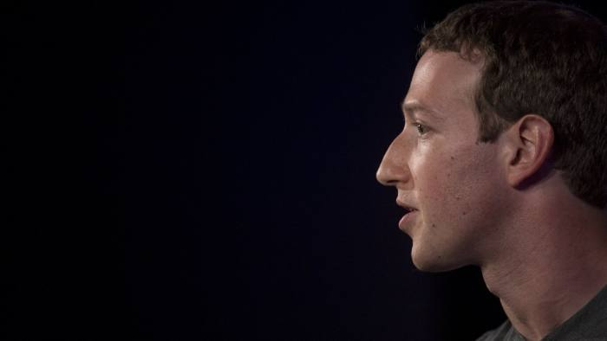
People’s attitude
Lost $60 billion from its market value in few days
Shares decrease for 4.9 percent
Most of the people have already fallen out of love
Might be thinking of deleting their account.

Slide 8
Recommendations
Immediately stop sharing data about political and religious preferences with advertisers and third parties
Restrict the sharing of information with third-party apps on its platform
Notes:
That would make it harder for malicious advertisers to target people who are more susceptible to fake news and propaganda.
Facebook automatically shares a person’s name, profile picture, cover photo, gender, networks, email and Facebook ID with all third-party apps, without any review process. Such pieces of data are unnecessary for most apps and it would be sufficient to share only the Facebook ID and perhaps the email with them. These common sense restrictions will greatly reduce the risk of abuse by malicious actors.

Slide 9
Recommendations
Stop the direct sharing of data about a user’s likes, posts, comments, videos and books with third-party apps
Have a transparent and stringent process to audit and approve apps that do require personally identifiable information and the companies behind them
Notes:
There is already a review process in place before an app receives such permissions. What Facebook should do is to take further steps to prevent data extraction by third parties. It could create a sanitisation layer so that apps can reference confidential data without being able to extract it.
That would signal that Facebook takes privacy seriously and that there could be legal consequences for the misuse of data.

Slide 10
Thanks for listening
Presented by Stephanie

